Slide 1
POLYMORPHISM
1

Slide 2
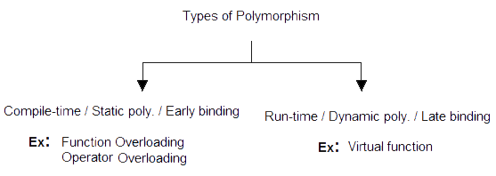
Introduction
2

Slide 3
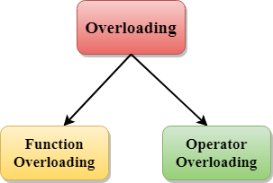
Overloading in C++
- Overloading refers to the use of the same thing for different purposes.
3

Slide 4
Function Overloading
Function overloading is a feature in C++ where two or more functions can
have the same name but different argument lists.
The function would perform different operations depending on the arguments in the function call.
The correct function to be invoked is determined by checking the number and type of the arguments but not the function type.
4

Slide 5
Function Overloading
long add(long c, long g)
{
long sum; sum = c + g; return sum;
}
Example 01
#include <iostream> using namespace std; long add(long, long); float add(float, float); int main()
{
long a, b, c; float e, f, g;
cout << "Enter two integers\n"; cin >> a >> b;
c = add(a, b);
cout << "Sum of integers: " << c << endl; cout << "Enter two floating point numbers\n"; cin >> e >> f;
g = add(e, f);
cout << "Sum of floats: " << g << endl;
}
float add(float c, float g)
{
float sum; sum = c + g; return sum;
}
Output
Enter two integers
2
3
Sum of integers: 5
Enter two floating point numbers
2.2
1.2
Sum of floats: 3.4
5

Slide 6
Function Overloading
Example 02
#include <iostream> using namespace std; long add(long, long); float add(float, float);
float add(float, float,float); int main()
{
long a, b, c; float e, f, g,h;
cout << "Enter two integers\n"; cin >> a >> b;
c = add(a, b);
cout << "Sum of integers: " << c << endl; cout << "Enter two floating point numbers\n"; cin >> e >> f;
g = add(e, f);
cout << "Sum of floats: " << g << endl;
cout << "Enter three floating point numbers\n";
cin >> e >> f >> h;
g = add(e, f, h);
cout << "Sum of floats: " << g << endl;
long add(long c, long g)
{
long sum; sum = c + g; return sum;
}
float add(float c, float g)
{
float sum; sum = c + g; return sum;
}
float add(float c, float g, float z)
{
float sum;
sum = c + g + z; return sum;
}
6
}

Slide 7
Function Overloading
Example 02
Output
Enter two integers 2
3
Sum of integers: 5
Enter two floating point numbers 2.2
1.2
Sum of floats: 3.4
Enter three floating point numbers 1.1
2.2
3.3
Sum of floats: 6.6
7

Slide 8
Operator Overloading
C++ has the ability to provide the operators with a special meaning for the data types.
The mechanism of giving such a special meaning to an operator is known as Operator Overloading.
The process of making an operator to exhibit different behaviors in different instances is known as operator overloading.
8

Slide 9
Defining Operator Overloading
The general form of an operator function is
Return_type classname :: operator op(arg)
{
// function body
}
Operator function can be either member function or friend function
if it is friend function then it will have only one argument for unary operators and two for binary operators
if it is member function then it has no arguments for unary
operators and only one for binary operators
9

Slide 10
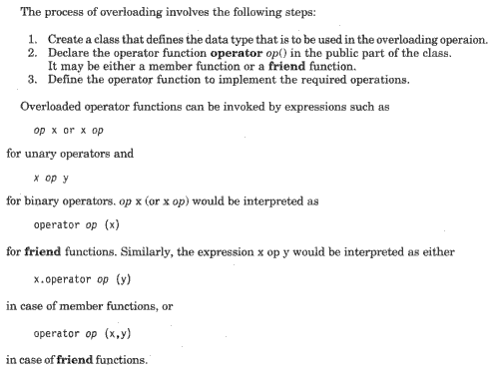
Operator Overloading
10

Slide 11
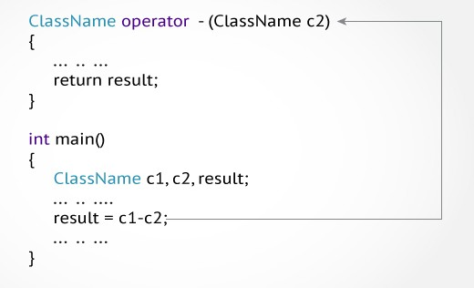
Overloaded Operator Call
11

Slide 12
Unary Operator Overloading
Example 03
#include <iostream>
using namespace std;
class Test
{
private:
int count;
public:
Test()
{ count = 5;
}
void operator ++()
{
count = count+1;
}
void Display()
{
cout<<"Count: "<<count;
}
};
int main()
{
Test t;
++t;
t.Display(); return 0;
}
Output
Count: 6
12

Slide 13
void display()
{
Example 04
#include<iostream> using namespace std; class ID
{
int a, b;
public:
void accept()
{
cout<<"\n Enter Two Numbers : \n";
cout<<" ";
cin>>a;
cout<<"\n A : "<<a; cout<<"\n B : "<<b;
}
};
int main()
{
ID id;
id.accept();
cout<<" "; cin>>b;
--id;
cout<<"\n After Decrementing : "; id.display();
++id;
++id;
cout<<"\n\n After Incrementing : id.display();
return 0;
}
13
Output:
Enter Two Numbers : 3 4
After Decrementing : A : 2
B : 3
After Incrementing : A : 4
B : 5
Output
Enter Two Numbers : 3 4
After Decrementing : A : 2
B : 3
After Incrementing :"; A : 4
B : 5
}
void operator--() {
a--;
b--;
}
void operator++() {
a++;
b++;
}

Slide 14
Binary Operator Overloading
Example 05
temp.real = real - c2.real; temp.imag = imag - c2.imag;
return temp;
}
void output()
{
cout << "Output Complex number: " << real << "+" << imag << "i";
}
};
int main()
{
Complex c1, c2, result;
cout<<"Enter first complex number: \n";
c1.input();
cout<<"Enter second complex number:\n";
c2.input(); result = c1 - c2; result.output(); return 0;
#include <iostream> using namespace std; class Complex
{
private:
float real; float imag; public:
Complex()
{
real =0; imag=0; }
void input()
{
cout << "Enter real and imaginary
Parts respectively: ";
cin >> real; cin >> imag;
}
Complex operator - (Complex c2)
{
Complex temp;
}
14

Slide 15
Binary Operator Overloading
Example 05
Output
Enter first complex number:
Enter real and imaginary Parts respectively: 4 3
Enter second complex number:
Enter real and imaginary Parts respectively: 2 1
Output Complex number: 2+2i

Slide 16
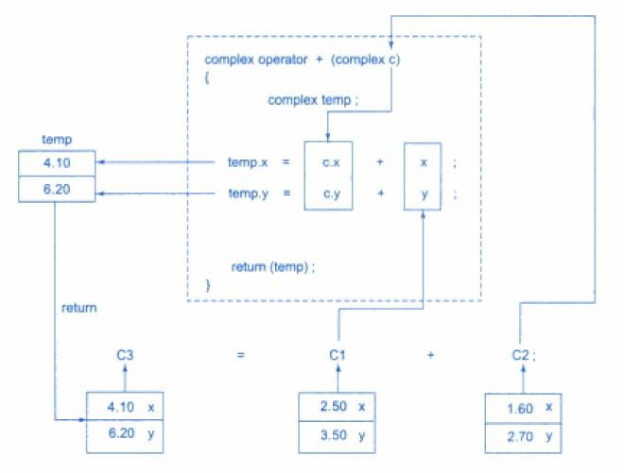
How overloaded module works?

Slide 17
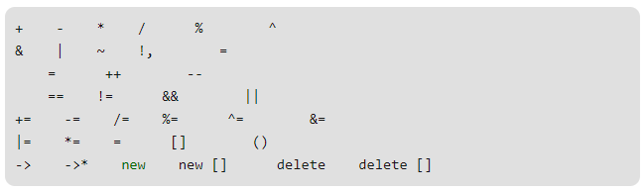
Operators that can be Overloaded

Slide 18
Operators that cannot be Overloaded
Scope Resolution Operator (::)
Pointer-to-member Operator (.*)
Member Access or Dot operator (.)
Ternary or Conditional Operator (?:)
Object size Operator
Object type Operator
(sizeof) (typeid)

Slide 19
Operator Overloading using Friend
Friend function using operator overloading offers better flexibility
to the class.
These functions are not a members of the class and they do not have 'this' pointer.
When you overload
argument.
When you overload arguments.
a unary operator you have to pass one
a binary operator you have to pass two
Friend function can access private members of a class directly.
friend return-type operator operator-symbol (Var 1, Var 2)
{
//Statements;
}

Slide 20
Operator Overloading using Friend
Example 6
#include<iostream> using namespace std; class UnaryFriend
{
int a=10; int b=20; int c=30; public:
void getvalues()
{
cout<<"Values of A, B & C\n"; cout<<a<<"\n"<<b<<"\n"<<c<<"\n"<<endl;
}
void show()
{
cout<<a<<"\n"<<b<<"\n"<<c<<"\n"<<endl;
}
void friend operator-(UnaryFriend &x);
};

Slide 21
void operator-(UnaryFriend &x)
{
Example 6 Continuation..
x.a = -x.a;
x.b = -x.b;
x.c = -x.c;
}
int main()
{
UnaryFriend x1; x1.getvalues();
cout<<"Before Overloading\n";
x1.show();
cout<<"After Overloading \n";
-x1;
x1.show();
return 0;
}

Slide 22
Operator Overloading using Friend
#include<iostream> using namespace std;
Example 7
class Complex
{
int num1, num2; public:
void accept()
{
cout<<"\n Enter Two Complex Numbers : ";
cin>>num1>>num2;
}
friend Complex operator+(Complex c1, Complex c2);
void display()
{
cout<<num1<<"+"<<num2<<"i"<<"\n";
}
};

Slide 23
Complex operator+(Complex c1, Complex c2)
{
Complex c; c.num1=c1.num1+c2.num1; c.num2=c1.num2+c2.num2; return(c);
}
int main()
{
Complex c1,c2, sum;
c1.accept();
c2.accept(); sum = c1+c2;
cout<<"\n Entered Values : \n"; cout<<"\t";
c1.display(); cout<<"\t"; c2.display();
Example 7 Continuation..
cout<<"\n Addition of Real and Imaginary Numbers : \n"; cout<<"\t";
sum.display(); return 0;
}

Slide 24
List of operators where friend cannot be used
Assignment operator =
Function call ( )
Subscripting operator [ ]
Class member access operator ->

Slide 25
Rules for Operator Overloading
Only existing operators can be overloaded
The overloaded operator must have atleast one operand i.e. user-defined type
Some operators cannot be overloaded
The precedence of the operators remains same
Overloaded operators cannot have default arguments.
if the overloaded function is a friend function then it will have only one argument for unary operators and two for binary operators
if the overloaded function is a member function then it has no arguments for
unary operators and only one for binary operators

Slide 26
References
Herbert Schildt, C++: The Complete Reference, 4th edition, Mc Graw Hill Education, 2017.
E.Balagurusamy, Object Oriented Programming with C++ (6th
edition), Mc Graw Hill Education, 2016.

